Slide 1

HSPH Capstone Project
Modeling Air Pollution
Members: Casey, Chris, Justin, and Keyan
TF: David Sondak

Slide 2


Our Partners
National Studies on
Air Pollution and Health (NSAPH)
Prof. Francesca Dominici, Dr. Christine Choirat, Ben Sabath
Harvard T.H. Chan School of Public Health

Slide 3

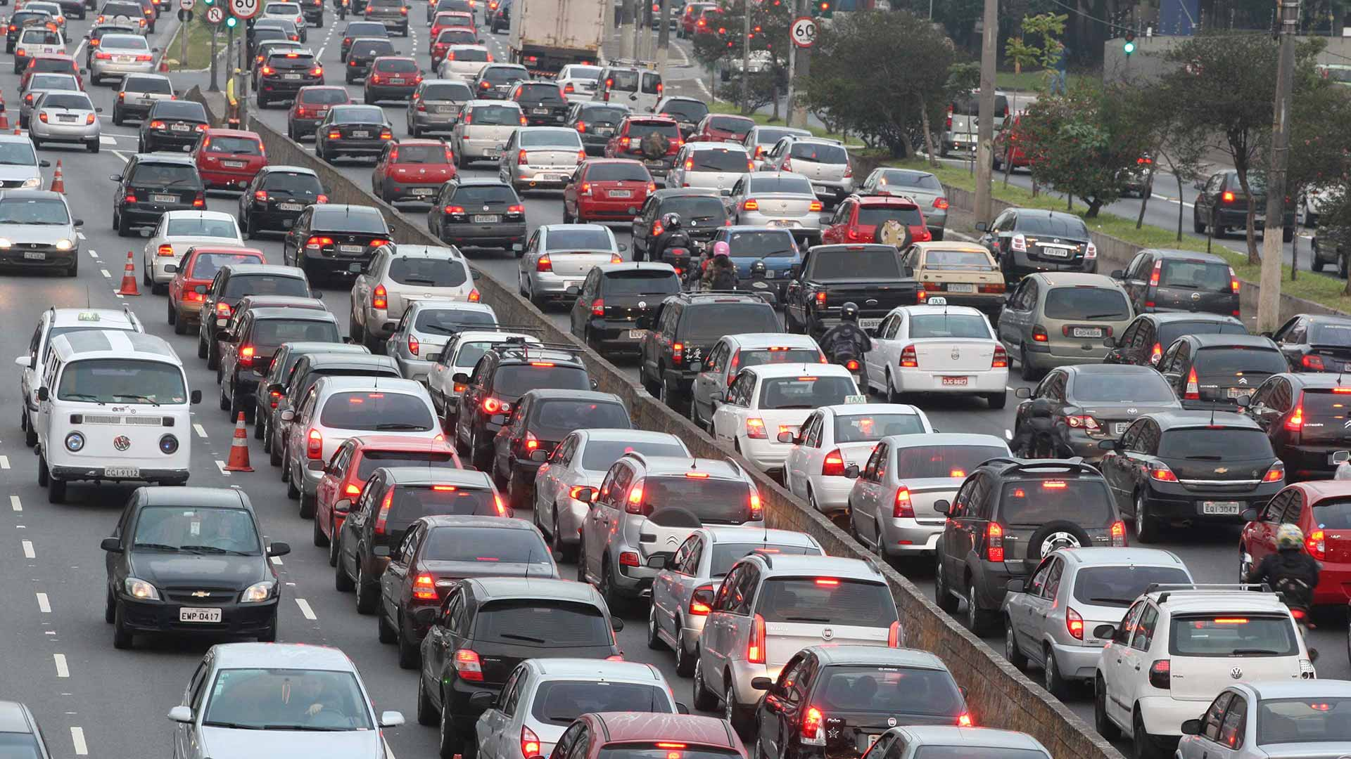


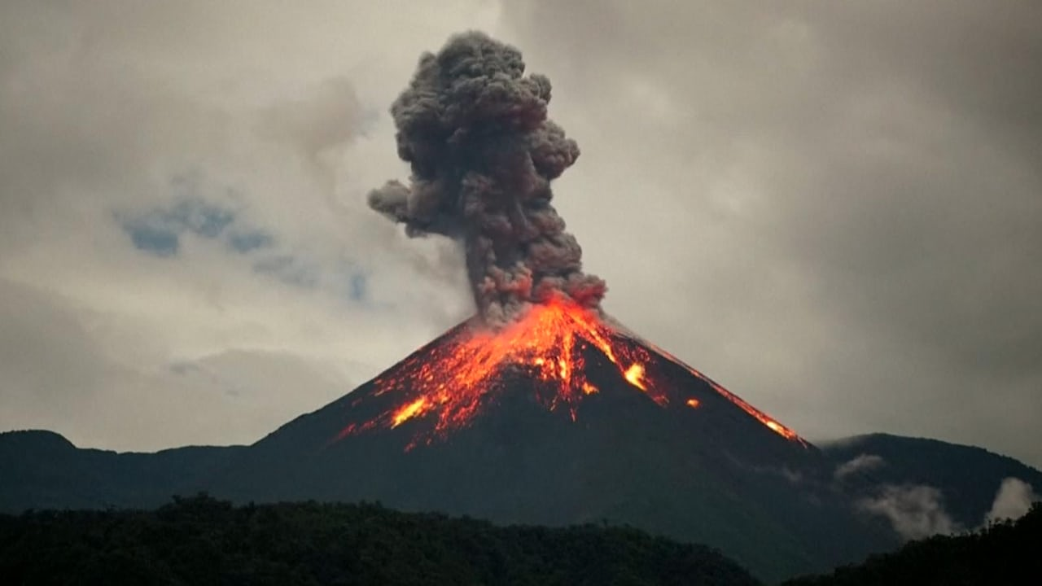
What’s the Problem?
Problem Statement
Motivation

Slide 4
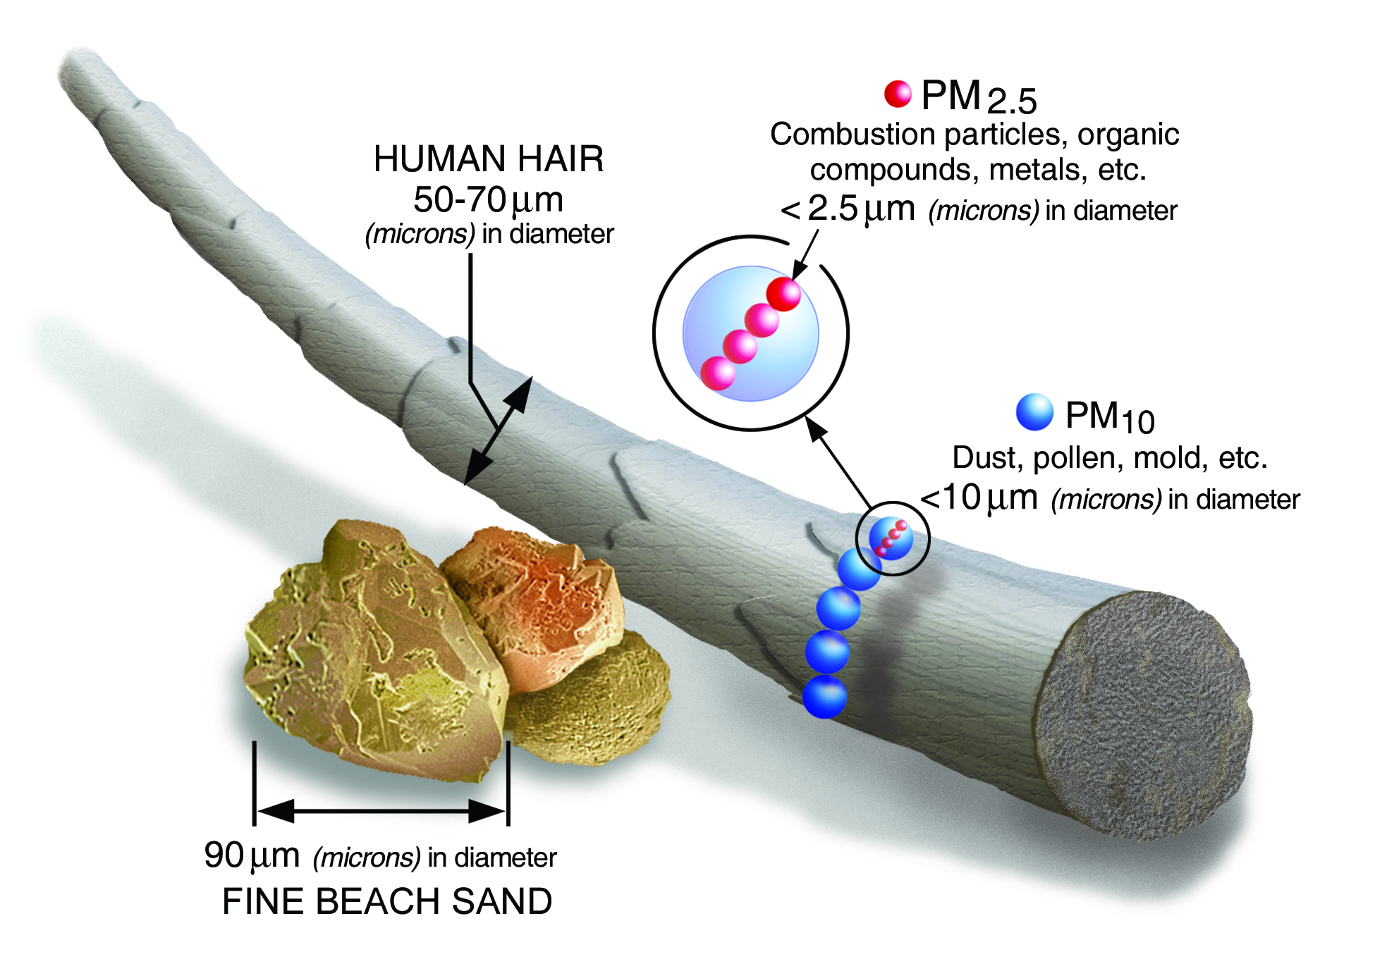
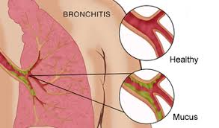

PM_{2.5} Is the Problem
Fine Particulate Matter < 2.5 μm in diameter
Natural and artificial sources
Associated with a host of adverse short- and long-term health effects: asthma, bronchitis, lung cancer, …

Slide 5


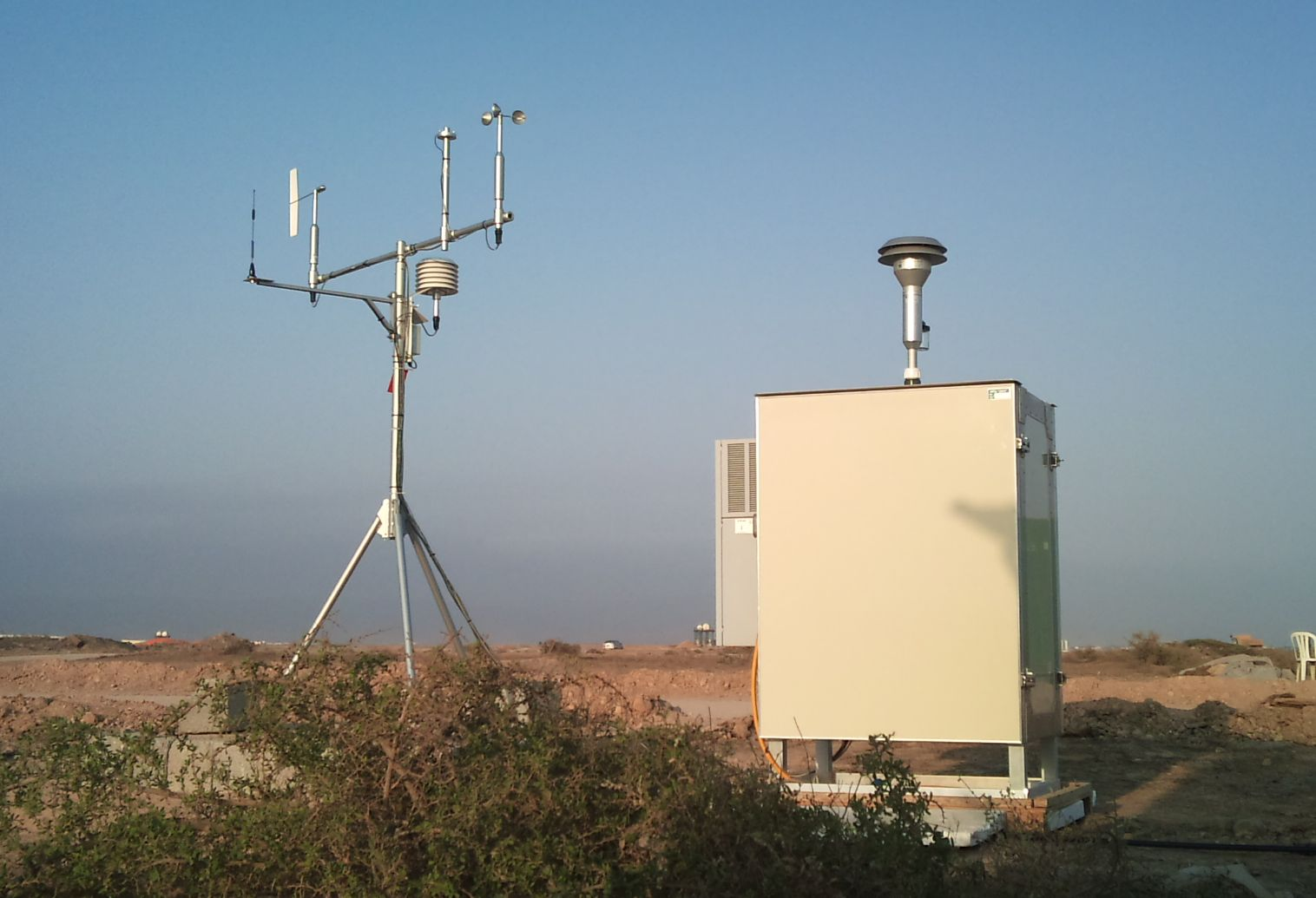
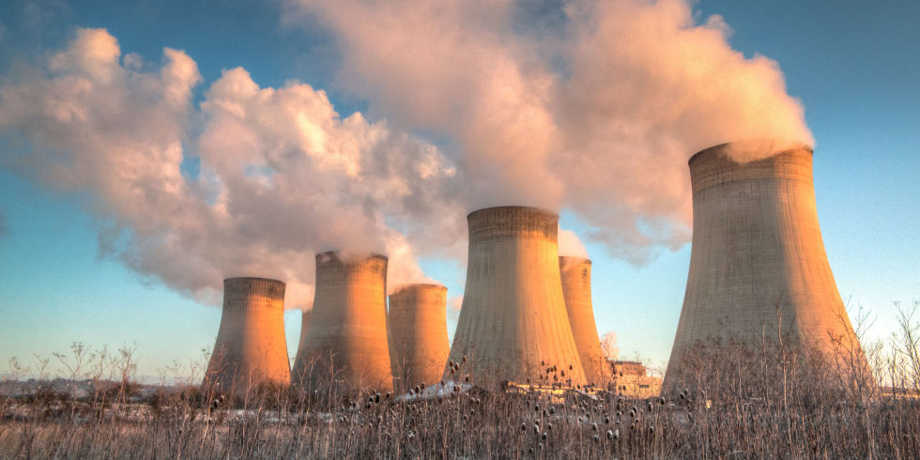
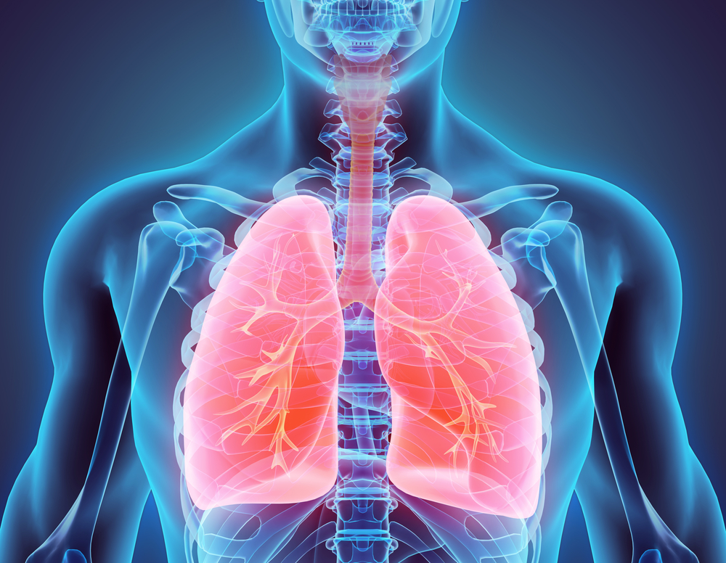

HSPH’s Goal
}

Slide 6
HSPH’s Goal
}
}

Slide 7
Motivation - Causal Inference
There are many areas in the US for which the PM_{2.5} concentrations are not known.
We cannot estimate the overall effect that pollution has on health if we do not know what the pollution is in those areas.
Thus, our goal was to fit a model that accurately interpolates pollution throughout the entire US on a daily basis.

Slide 8
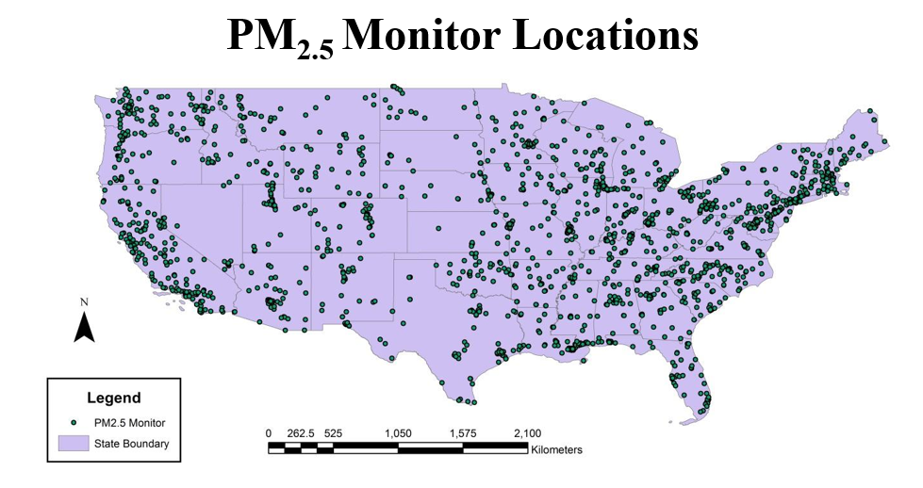
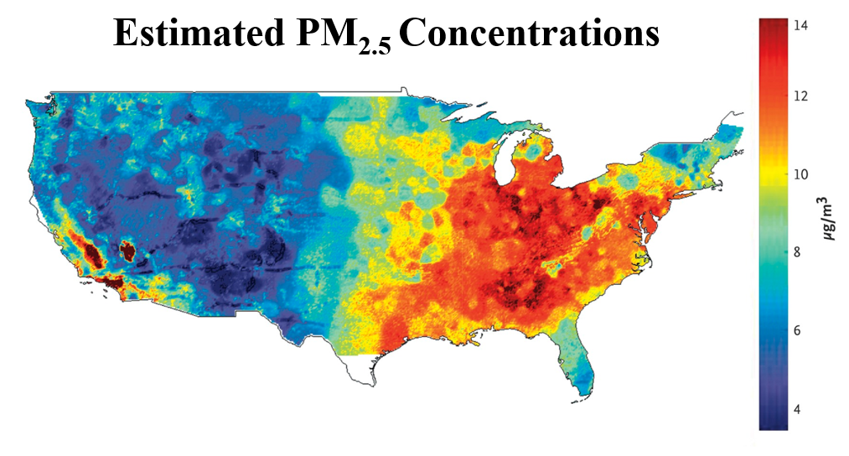

Spatial Interpolation

Slide 9
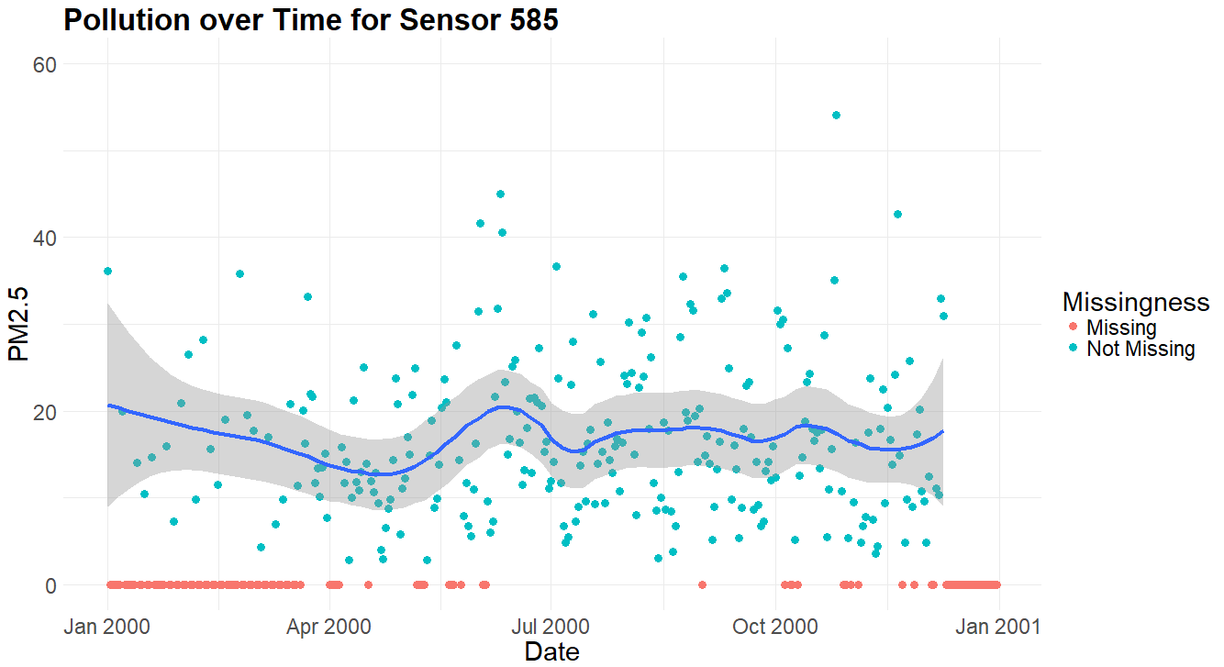
Temporal Interpolation

Slide 10
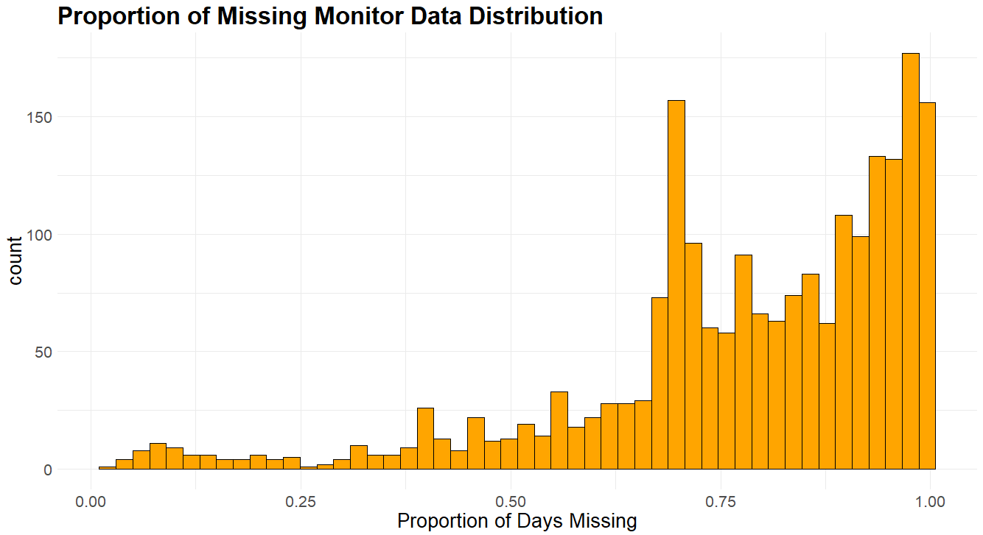
Temporal Interpolation

Slide 11
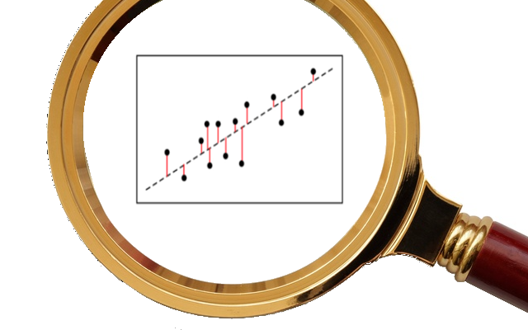
Data, Preprocessing, & EDA
Exploratory Data Analysis
Feature Correlations
Missing Data

Slide 12
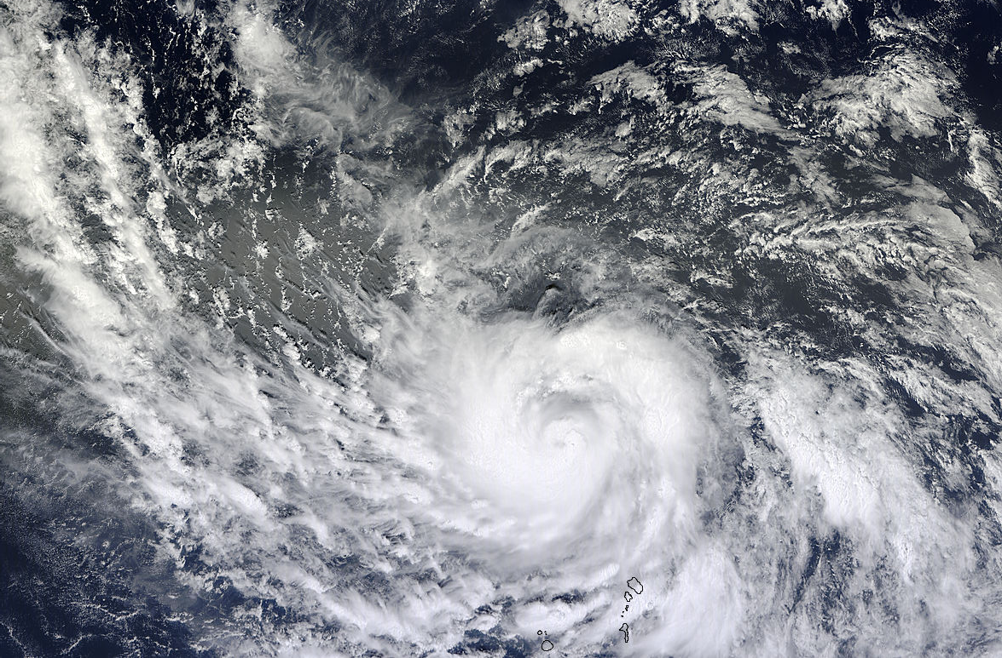
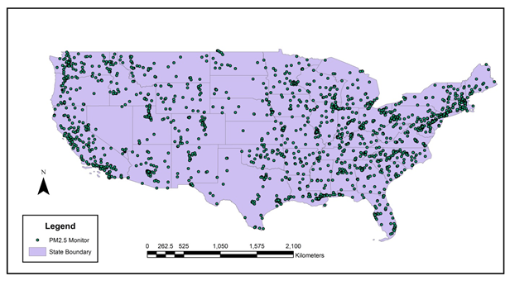
Given Data
16yrs
2156 Sites
Sensor Data
(Response)
Satellite Data
(Predictors)
13M PM_{2.5} Sensor-Days
~75% sensor-days missing
Defunded sites (costly)
115 measurements/day/site
Also severe missingness
Cloud cover
Snow reflection
Notes:
Making daily predictions
First, the data:
We have one response variable we’re trying to predict: PM2.5 concentration
Grand total of 13M sensor-days
BUT about 75% missing. Sites get defunded ~$1000/day
To predict the PM2.5 we have daily satellite measurements in high dimension: 115 different measurements per sensor site per day
Also has severe missingness for a number of environmental reasons

Slide 13

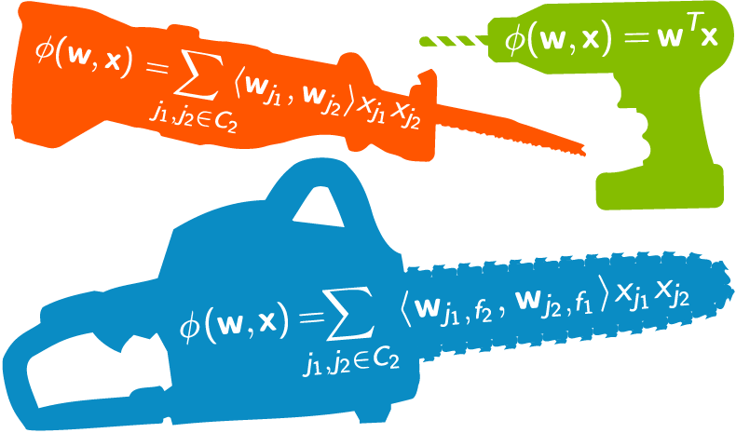
Added Data
Census Data
Engineered Features
Population Density
Income distribution
Education
Nearby PM_{2.5} lead
Periodic time domain features
Notes:
Making daily predictions
First, the data:
We have one response variable we’re trying to predict: PM2.5 concentration
Grand total of 13M sensor-days
BUT about 75% missing. Sites get defunded ~$1000/day
To predict the PM2.5 we have daily satellite measurements in high dimension: 115 different measurements per sensor site per day
Also has severe missingness for a number of environmental reasons

Slide 14
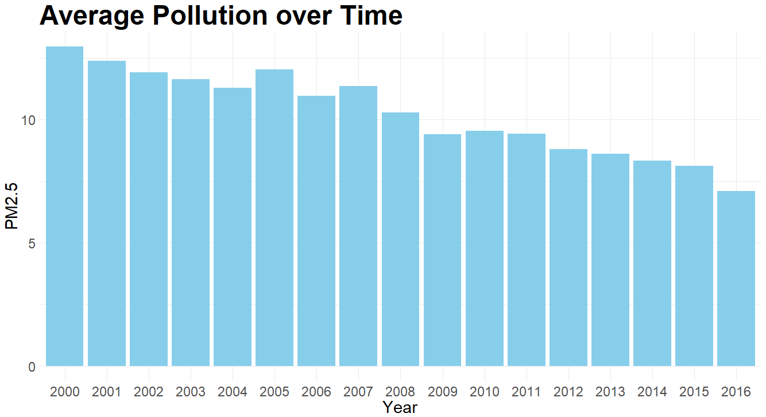
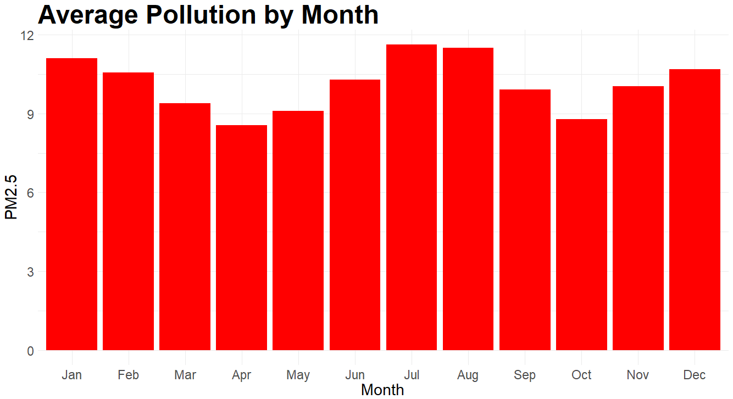
EDA - Pollution Over Time

Slide 15
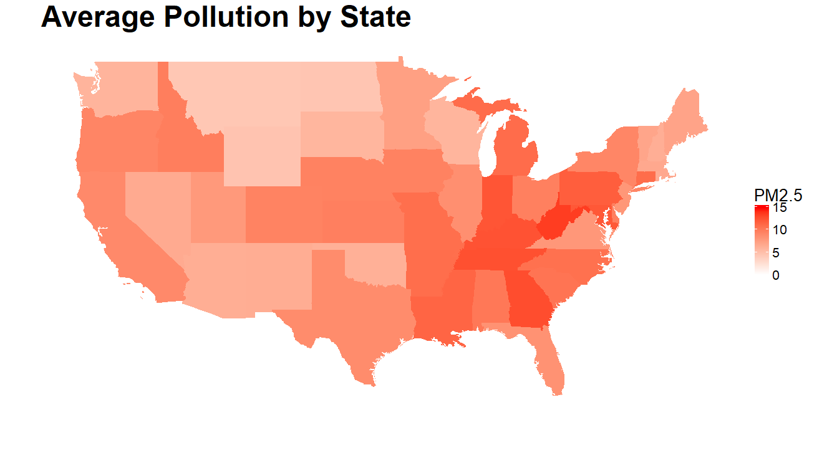
EDA - Pollution by Location

Slide 16
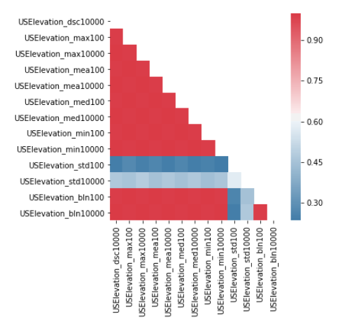
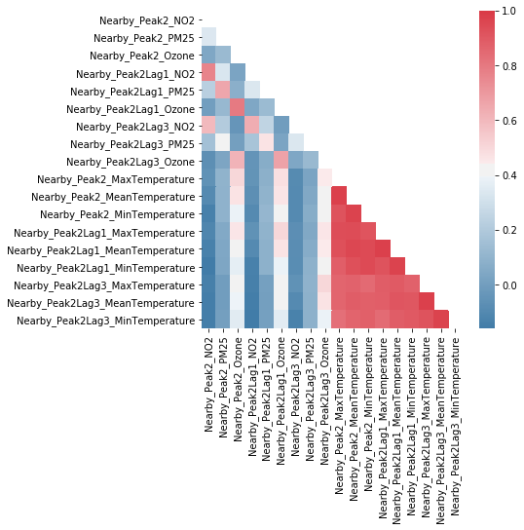
EDA - Pairwise Correlations

Slide 17
Dimensionality Reduction
For each pair of variables with greater than 0.9 correlation, drop one based on:
Correlation with response
Amount of missingness
Also removed variables that had non-significant partial correlations with PM_{2.5} after controlling for nearby PM_{2.5}
Notes:
Because of the high number of variables, we decided to perform variable selection. Having extraneous or redundant variables not only increases the computation time, but it can also harm the predictive performance of machine learning models.
To reduce dimensionality, for each set of highly correlated features, we removed all but one. We also removed variables that had non-significant partial correlations with PM2.5 after controlling for nearby PM2.5. On the right you can see a set of variables for which there were many high pairwise correlations.

Slide 18
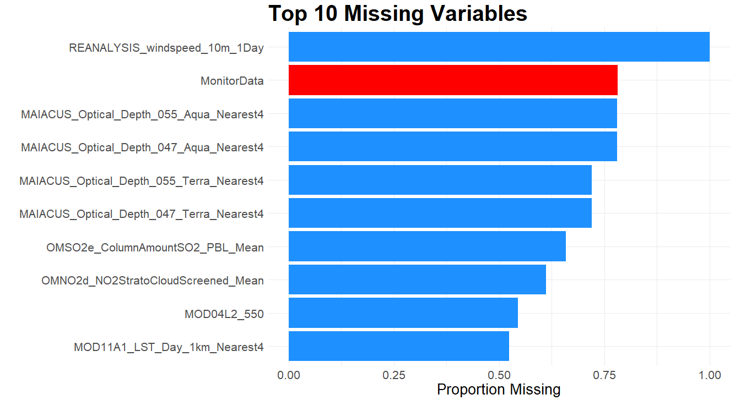
Missing Data
Notes:
One of the major challenges of this project was dealing with missing data. At least 10 variables in our dataset were over 50% missing, including our response variable, which is in red.

Slide 19
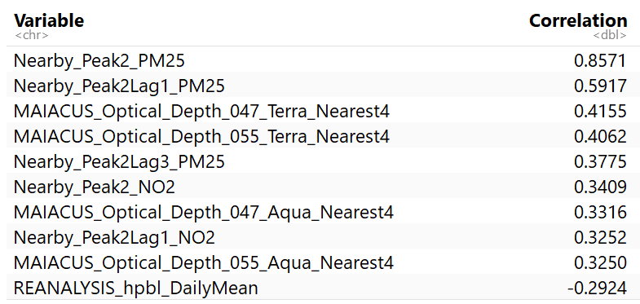
Correlations with PM_{2.5}
Notes:
We also looked at pairwise correlations of predictors and PM2.5.
The first thing to note is the high correlation of PM2.5 related predictors and PM2.5 response
Nearby current day PM2.5 is particularly correlated with the PM2.5 response
And, the optical depth variables, which were highly missing, have significant correlation with PM2.5 response, highlighting the need for a good data imputation scheme

Slide 20
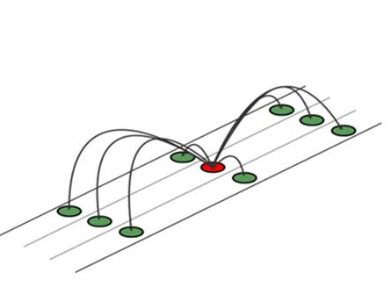
Imputing Missing Data
MissForest Algorithm
Modifications and Additions
Evaluation

Slide 21

MissForest Algorithm
Notes:
After some research, we found what we believed to be an effective, easy to use algorithm for our missing data problem
The MissForest algorithm was published in 2011, and is an iterative data imputation algorithm that uses random forest
This publication has been cited in 447 papers, so it appears to be quite popular

Slide 22
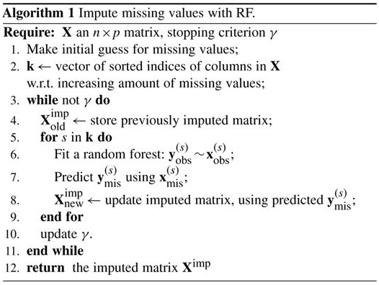
MissForest Algorithm
Perform mean imputation
For each variable with missing values:
Fit random forest using non-missing values as response and all other variables as predictors
Use fitted random forest to impute missing values
3. Repeat step 2 until:
Convergence stopping criterion reached OR
Max number of iterations reached

Slide 23

Modifications and Additions
Allow for use of ridge regression (or any scikit-learn model)
Significantly improves algorithm runtime
Imputation evaluation scheme
Perform imputation for non-missing values in holdout set and compute R²
Improvements for making imputations on new datasets
MissForest R package does not allow for imputation on new datasets without model re-fitting
Current Python implementation does not correctly follow the MissForest algorithm

Slide 24
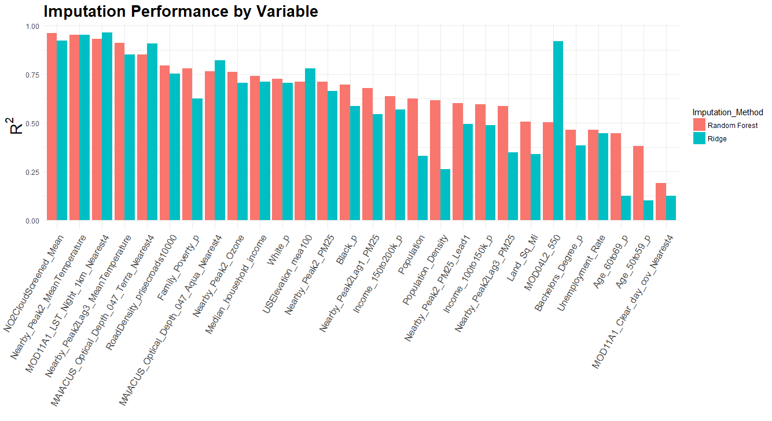
Notes:
Here is the imputaton performance by variable for the random forest variation and ridge variation
The imputations appear to be quite good relative to what mean imputation would achieve
The random forest imputations appear to be better for the majority of variables based on R^2
In fact, our final model performances were slightly better when using the random forest imputations than when using the ridge imputations

Slide 25

Modeling
Setup
Baseline Model
Scikit-Learn Models
CNN
Evaluation

Slide 26
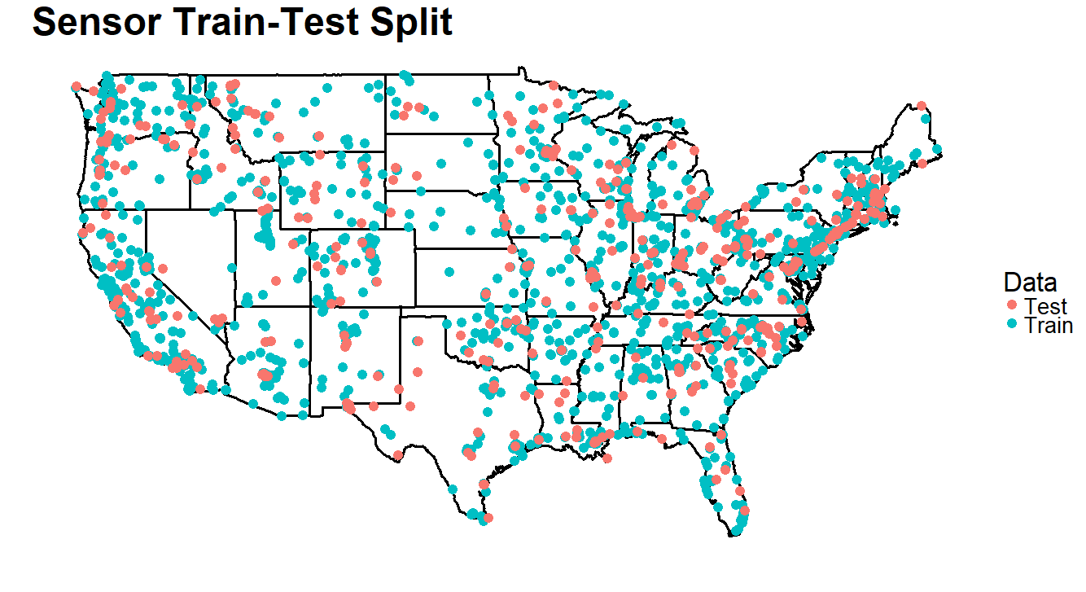
Modeling Setup
Trained models on a random 80% sample of sensors
Reserved the remaining sensors for testing
Tuned all hyper-parameters using K-fold cross-validation.
Optimizing for R²
Notes:
We trained our models on a random 80% sample of sensors, and we reserved the remaining sensors to test the performance of our models. We also tuned all hyper-parameters using K-fold cross-validation.

Slide 27
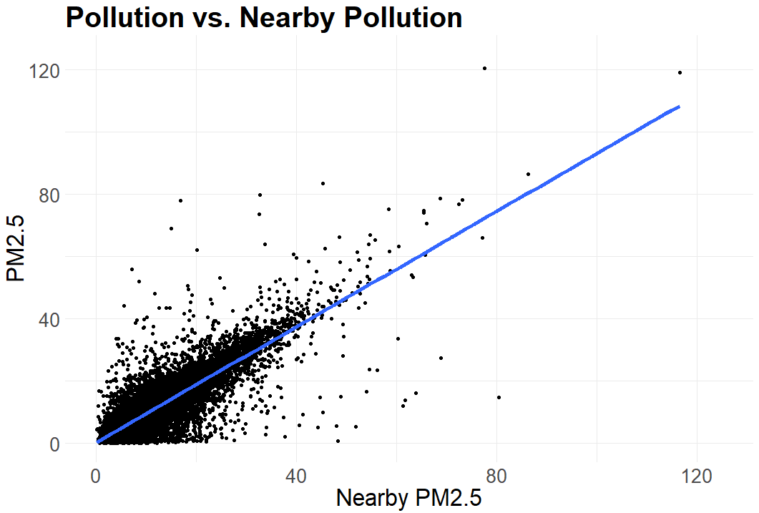
Baseline Model - Simple Linear Regression
Notes:
Based on the correlations between each of the predictors and PM_{2.5}, by far the most important linear predictor of PM_{2.5} was nearby PM_{2.5}. Thus, our baseline model was just a simple linear regression with nearby PM_{2.5} as the only predictor. Despite its simplicity, this model does surprisingly well with a test R² of 0.712. Below is a scatterplot of the relationship between PM_{2.5} and nearby PM_{2.5} on a random 1% subset of the data.

Slide 28
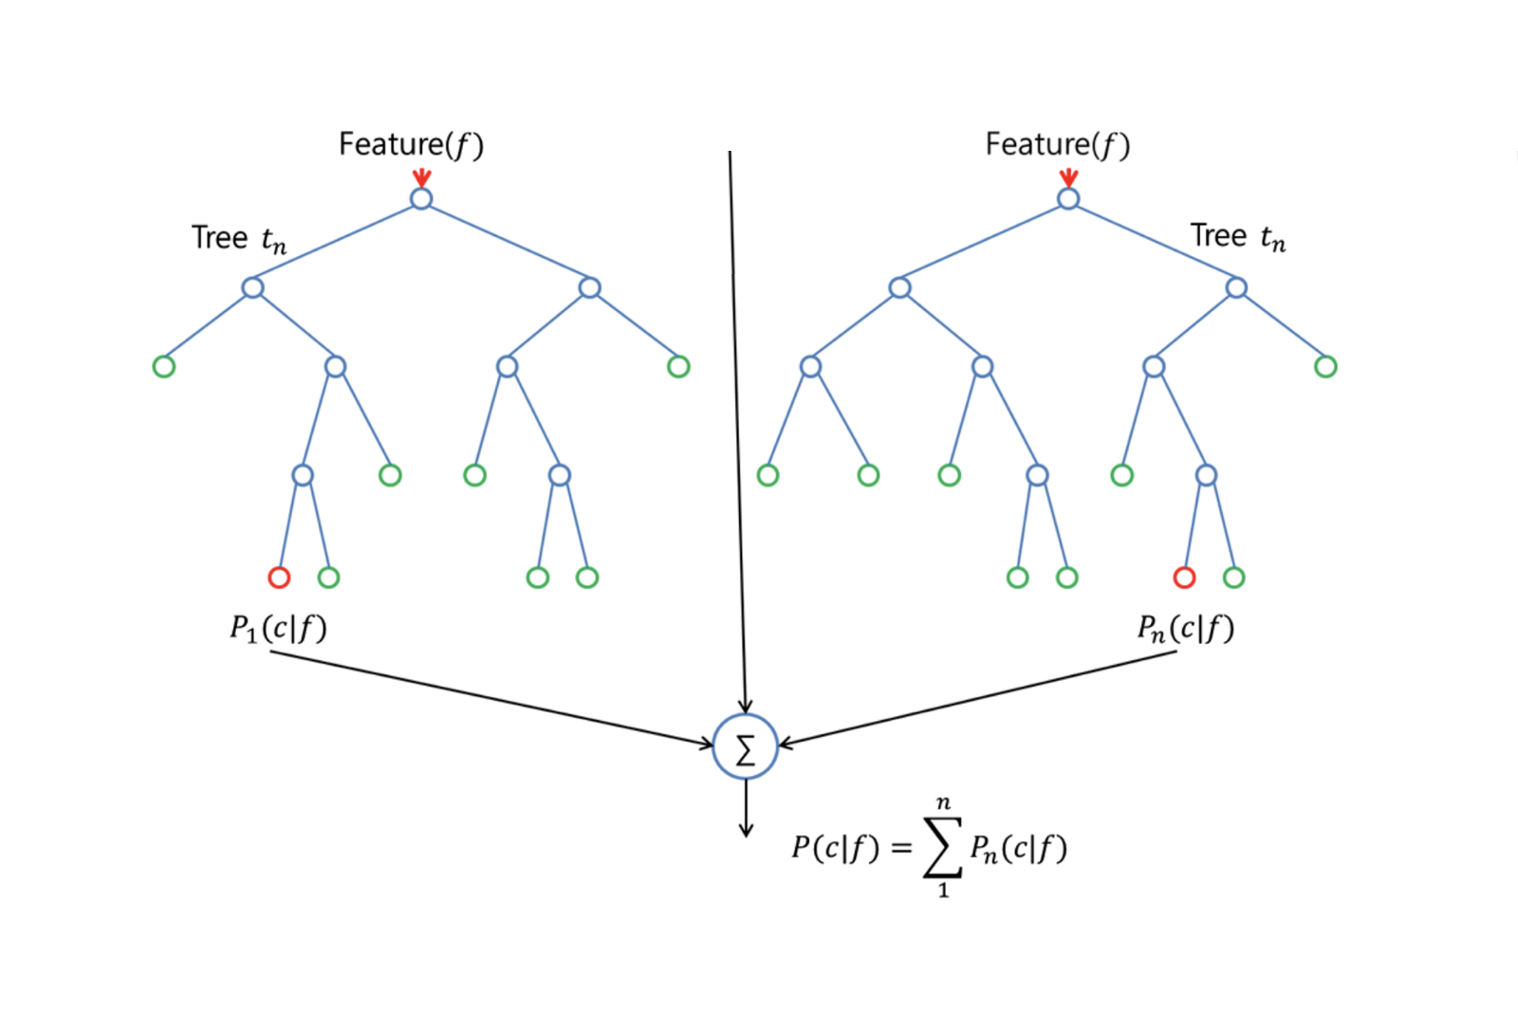
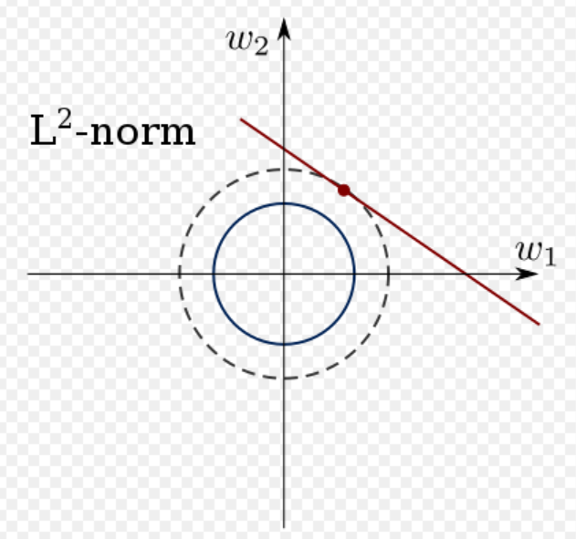
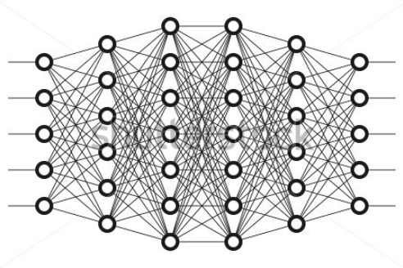
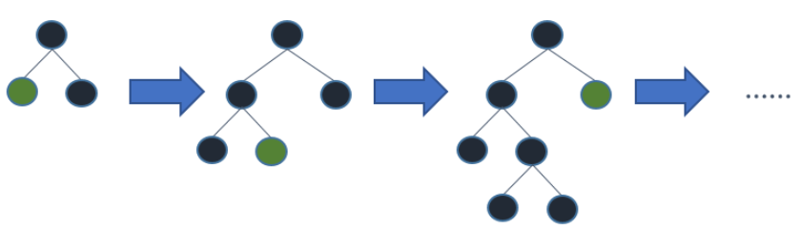
Modeling Methods Tested
Random Forest
Ridge
CNN
XGBoost
Notes:
The modeling methods we ended up comparing were ridge regression, random forest, extreme gradient boosting, and convolution neural networks

Slide 29
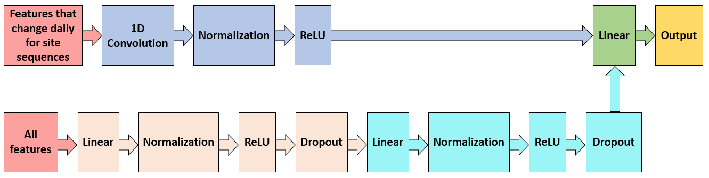
CNN Architecture
1D convolutional layer:
Inputs: Features that change on a daily basis within a site sequence
Kernel width of size 3: Relationships between features from previous day, current day, and following day accounted for when predicting pollution on current day
All features inputted to 2-layer fully connected component
Hidden units resulting from 1D convolution and 2-layer component concatenated
Notes:
Here is a diagram of our CNN architecture
Our CNN architecture accounts for the fact that we have two types of predictors:
Predictors that change daily throughout a site sequence AND
Predictors that are constant throughout a site sequence
We feed predictors that change daily to a 1D convolutional layer and use a kernel width of size 3
This means that the relationship between features from the previous day, current day, and following day is accounted for when predicting pollution on the current day
We feed all of the predictors for the current day, including those that are constant throughout the site sequence, to a 2-layer fully connected neural network
The hidden units that result from the convolutional layer and the 2-layer neural network are concatenated and fed to linear layer to produce the model output

Slide 30
Model Test R² Results
Notes:
Here are our final model test R^2 results
Our baseline model that was just a simple linear regression on nearby PM2.5 performed quite well with an R^2 of 0.712
Ridge regression using all selected predictors just performed slightly better
Across individual models, random forest performed the best, just beating out extreme gradient boosting and the CNN with an R^2 of 0.78.
And the best result came from an ensemble of the random forest, XGBoost, and the CNN and produced an R^2 of 0.784.

Slide 31
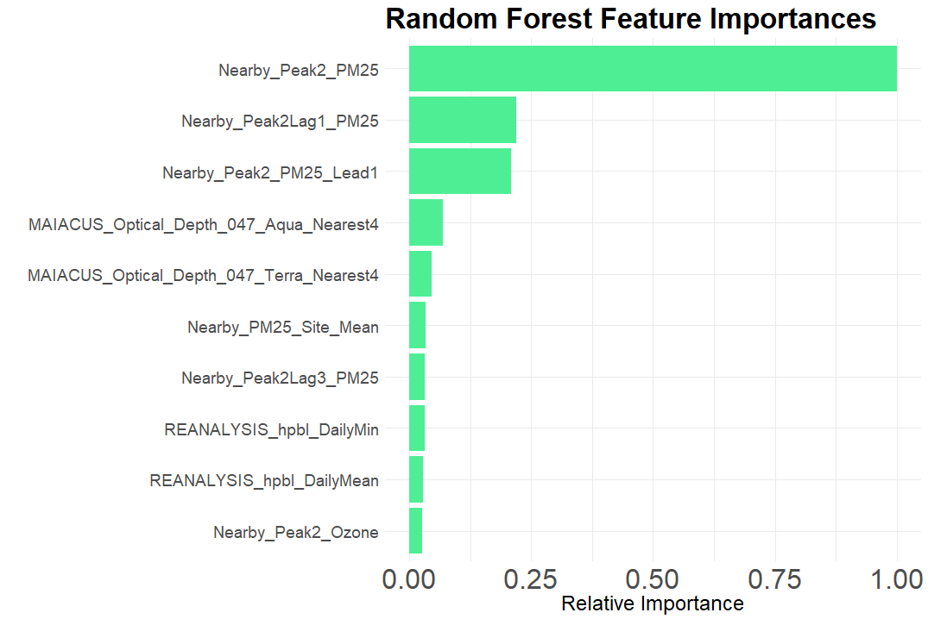
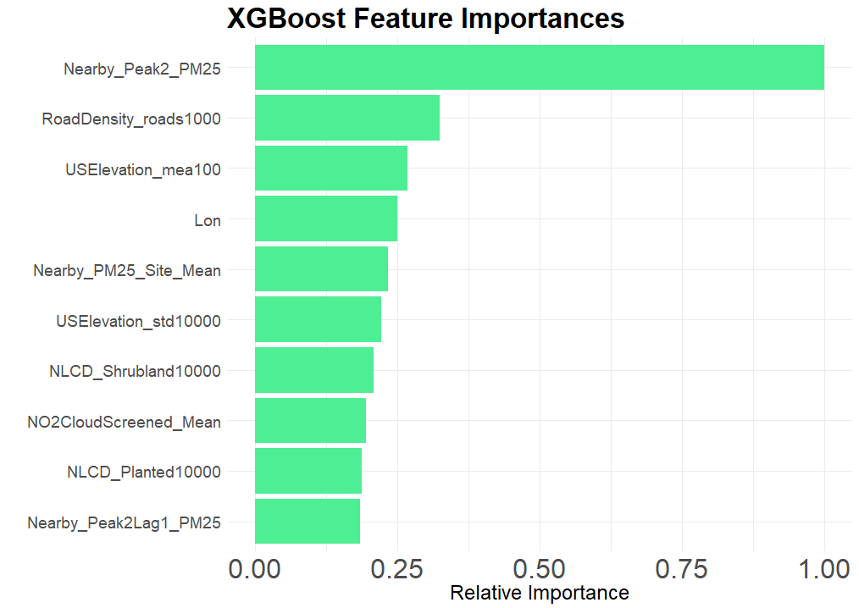
Feature Importances

Slide 32
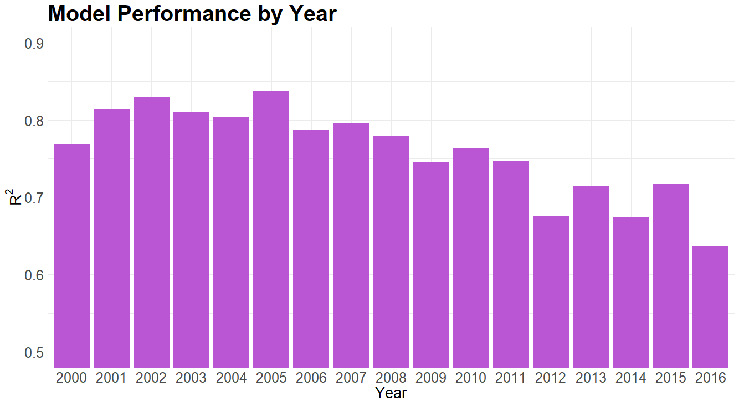
Model Diagnostics

Slide 33
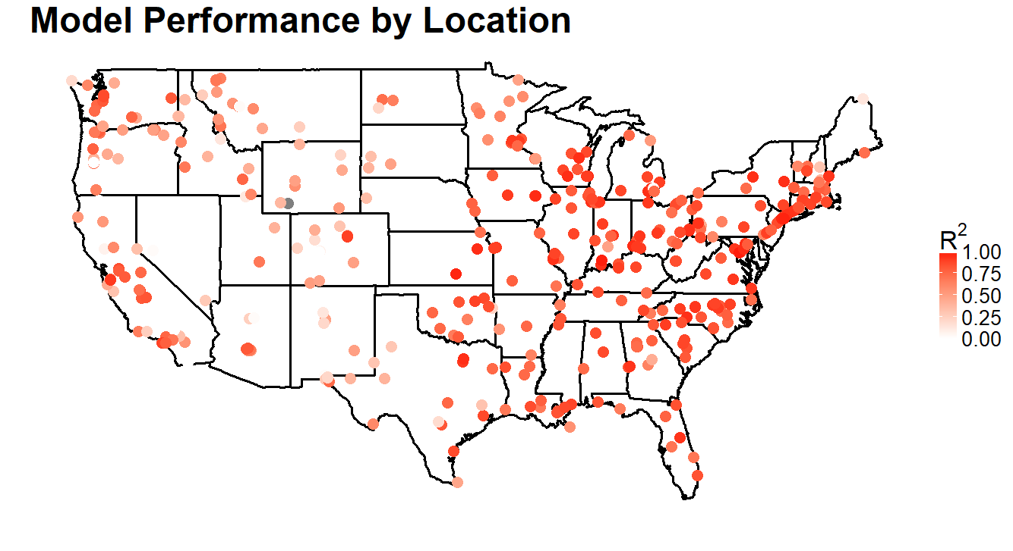
Model Diagnostics

Slide 34

Looking Ahead
Takeaways
Future Work

Slide 35
Takeaways
Because of the disproportionate importance of nearby PM_{2.5}, we believe that it is absolutely essential for more pollution monitors to be installed, especially in regions where there are few.
We also have evidence to suggest that our imputation procedure provides high quality imputations, and since the procedure is quite easy to implement, we recommend that HSPH use it in the future.

Slide 36
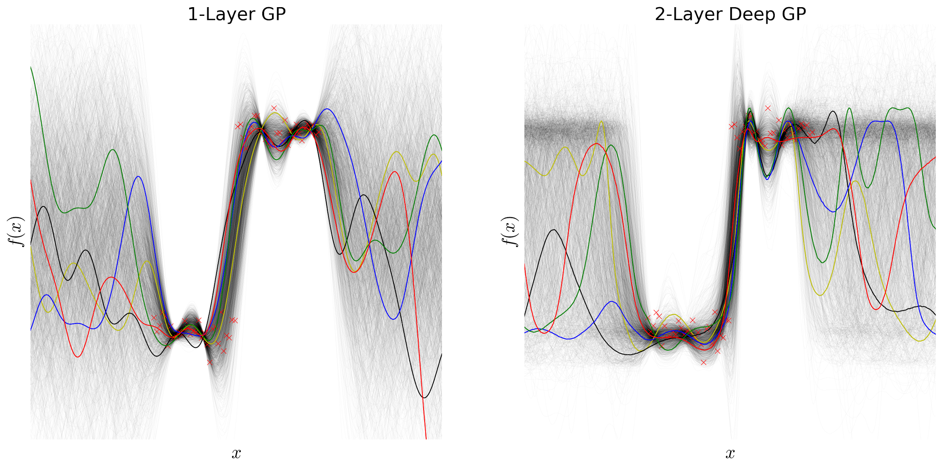
Future Work
LSTM, meta-learner
Uncertainty Quantification
More insight into model performance in areas that are far away from sensors
Allow for more accurate variance estimates of any associated causal effects
Prioritize placement of new sensors

Slide 37
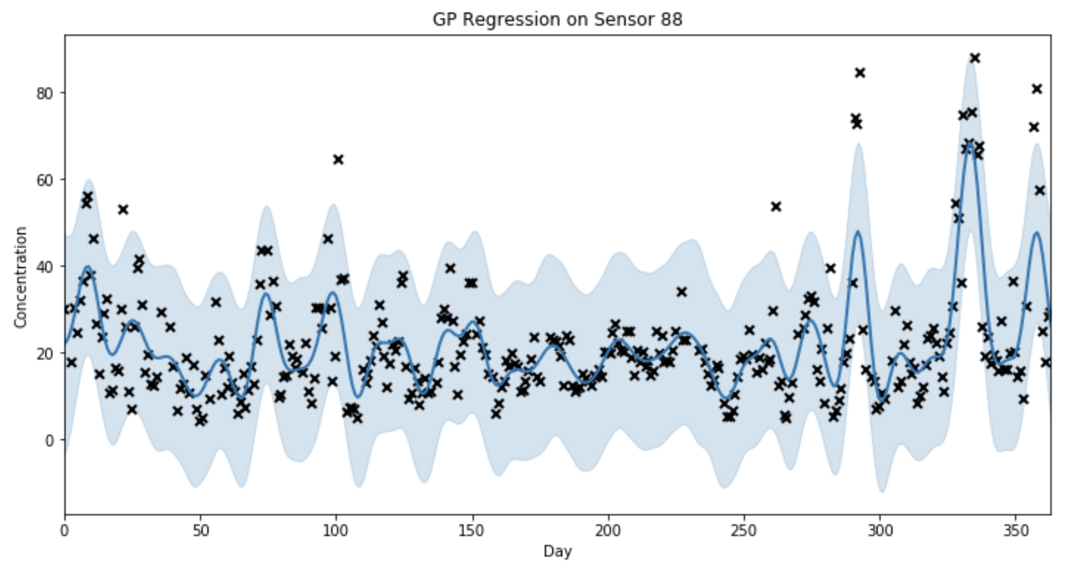
Gaussian Process Demo: Time

Slide 38
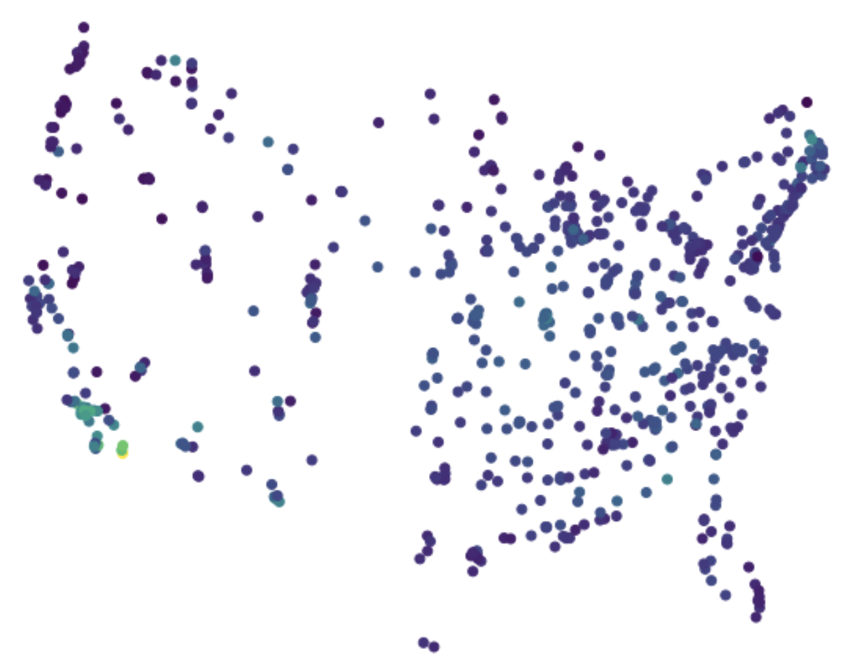
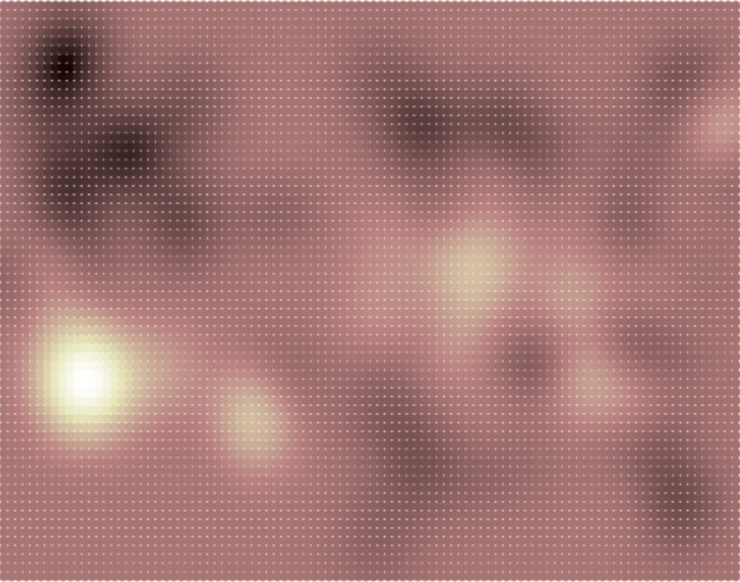
Gaussian Process Demo: Spatial (Mean Est.)

Slide 39
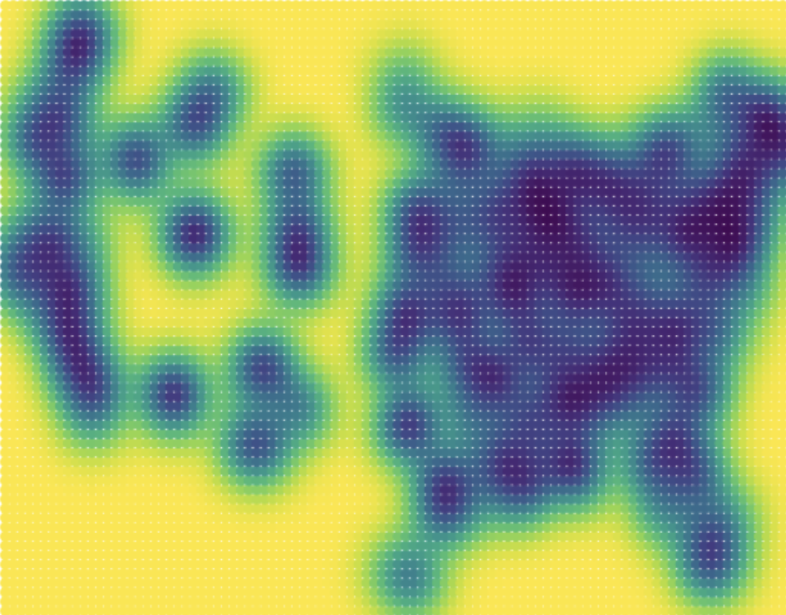
Gaussian Process Demo: Spatial (Variance)

Slide 40

Software Stuff
Extensible
Pipeline
Architecture

Slide 41
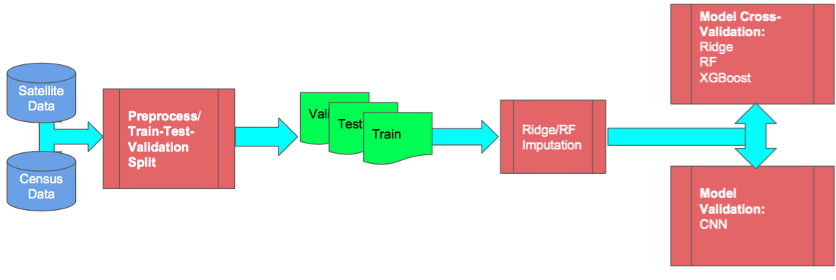
Software Stuff
Efficient imputation software for overcoming missingness
Easy to use machine learning pipeline
Extensible package for HSPH to use and develop going forward

Slide 42

Thank you!

